Slide 1
Database: The Guthenberg Project (20 books from Children’s Literature)
Started coding on a Jupyter Notebook to clean the dataset, split the books into paragraphs and sentences and play around with embeddings
First embedding : Sentence-BERT (cosine similarity = semantic distance)
Next step : Find the mathematical formulation for finding an ordering that minimizes the distance between neighbouring sentences (order 1) and implement it, consider higher orders ?

Slide 2
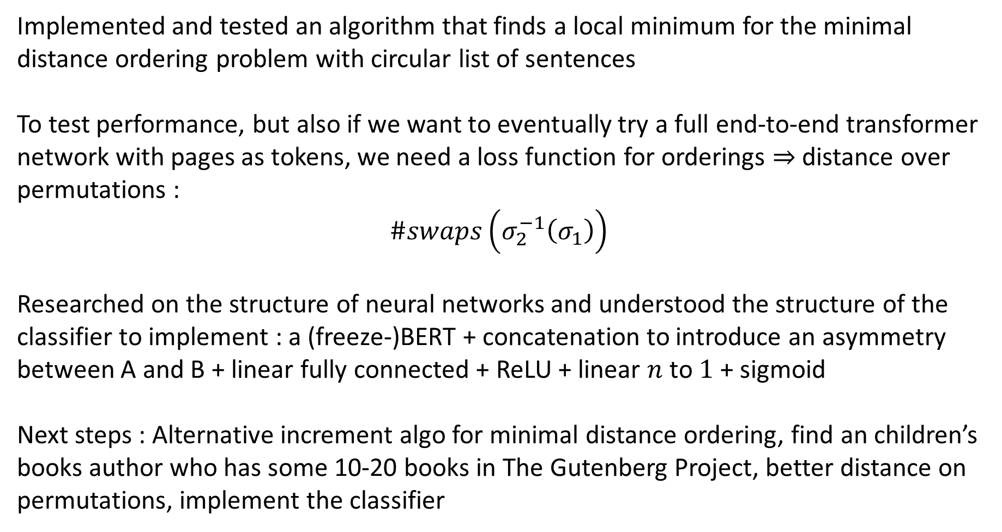
Implemented and tested an algorithm that finds a local minimum for the minimal distance ordering problem with circular list of sentences
To test performance, but also if we want to eventually try a full end-to-end transformer network with pages as tokens, we need a loss function for orderings $⇒$ distance over permutations :
$$\#swaps\left(σ_{2}^{−1}\left(σ_{1}\right)\right)$$
Researched on the structure of neural networks and understood the structure of the classifier to implement : a (freeze-)BERT + concatenation to introduce an asymmetry between A and B + linear fully connected + ReLU + linear $n$ to $1$ + sigmoid
Next steps : Alternative increment algo for minimal distance ordering, find an children’s books author who has some 10-20 books in The Gutenberg Project, better distance on permutations, implement the classifier

Slide 3
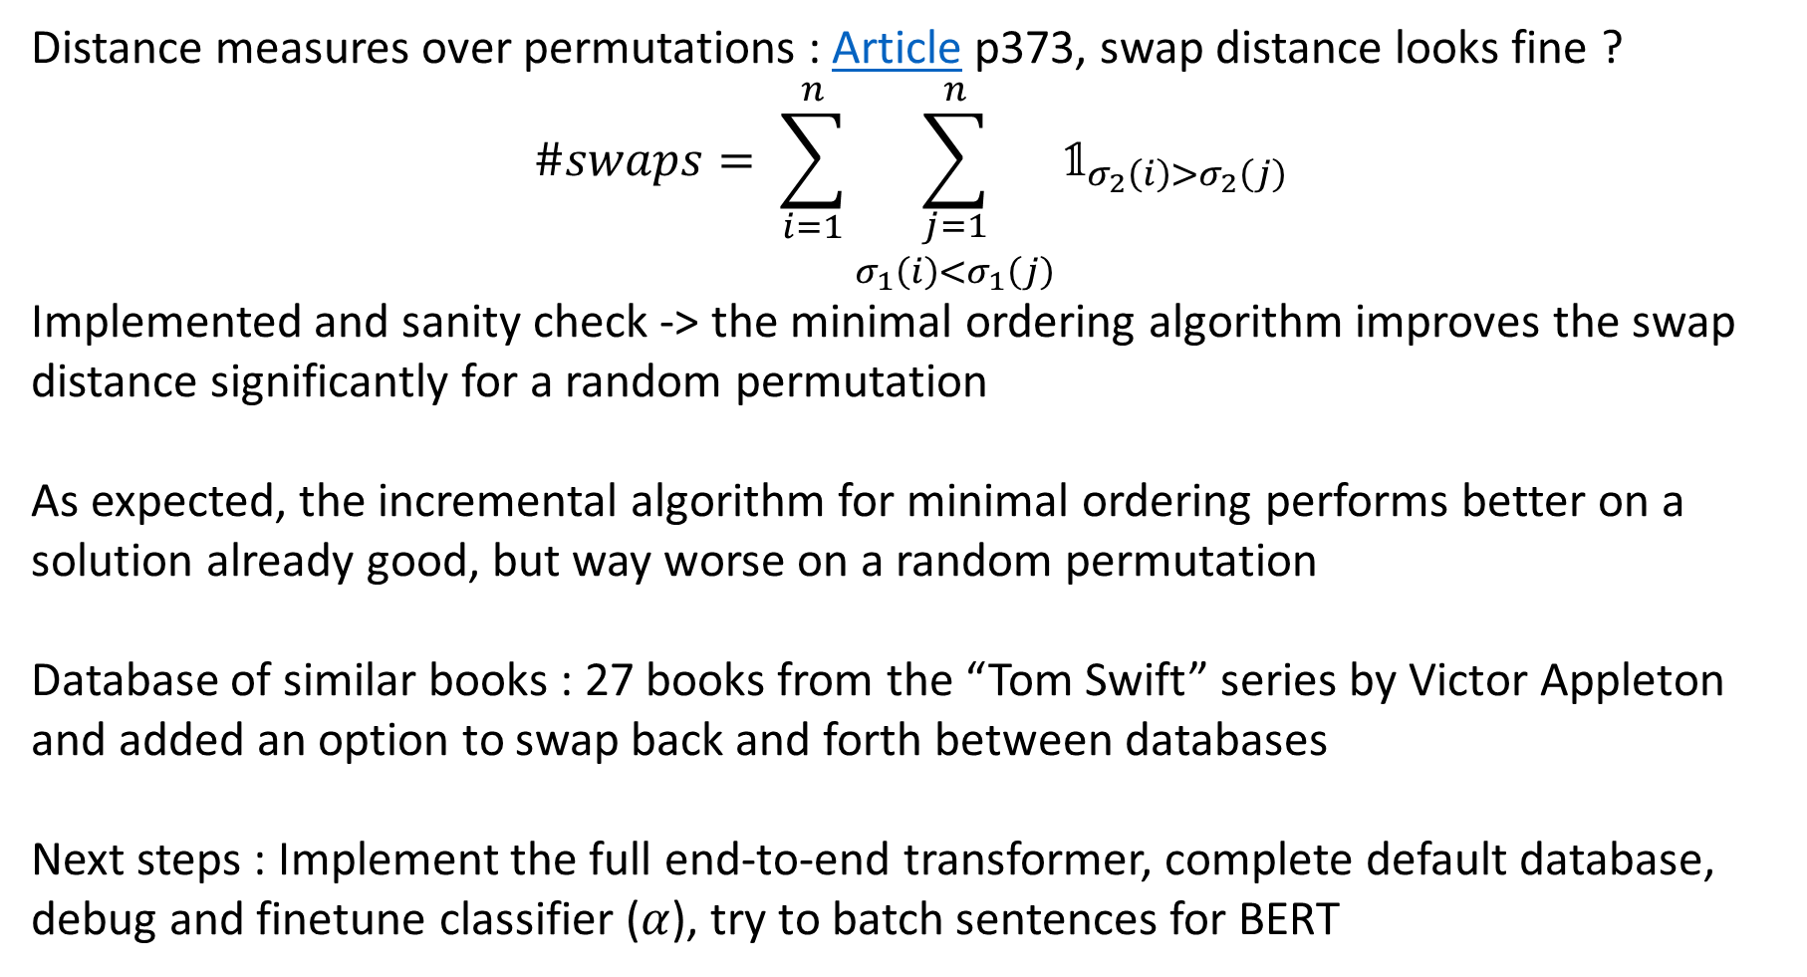
Distance measures over permutations : Article p373, swap distance looks fine ?
$$\#swaps= \sum_{i=1}^{n}{\sum_{\begin{aligned}j=1 \\ σ_{1}\left(i\right)<σ_{1}\left(j\right)\end{aligned}}^{n}{𝟙_{σ_{2}\left(i\right)>σ_{2}\left(j\right)}}}$$
Implemented and sanity check -> the minimal ordering algorithm improves the swap distance significantly for a random permutation
As expected, the incremental algorithm for minimal ordering performs better on a solution already good, but way worse on a random permutation
Database of similar books : 27 books from the “Tom Swift” series by Victor Appleton and added an option to swap back and forth between databases
Next steps : Implement the full end-to-end transformer, complete default database, debug and finetune classifier ($α$), try to batch sentences for BERT

Slide 4


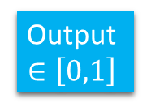


Classifier architecture
Freeze BERT
MLP
Sentence A
Vector
$$E_{A}$$
$2d×$128
128$×1$
@
ReLU
Sigmoid
Output
$$∈\left[0,1\right]$$
Freeze BERT
Sentence B
Vector
$$E_{B}$$

Slide 5
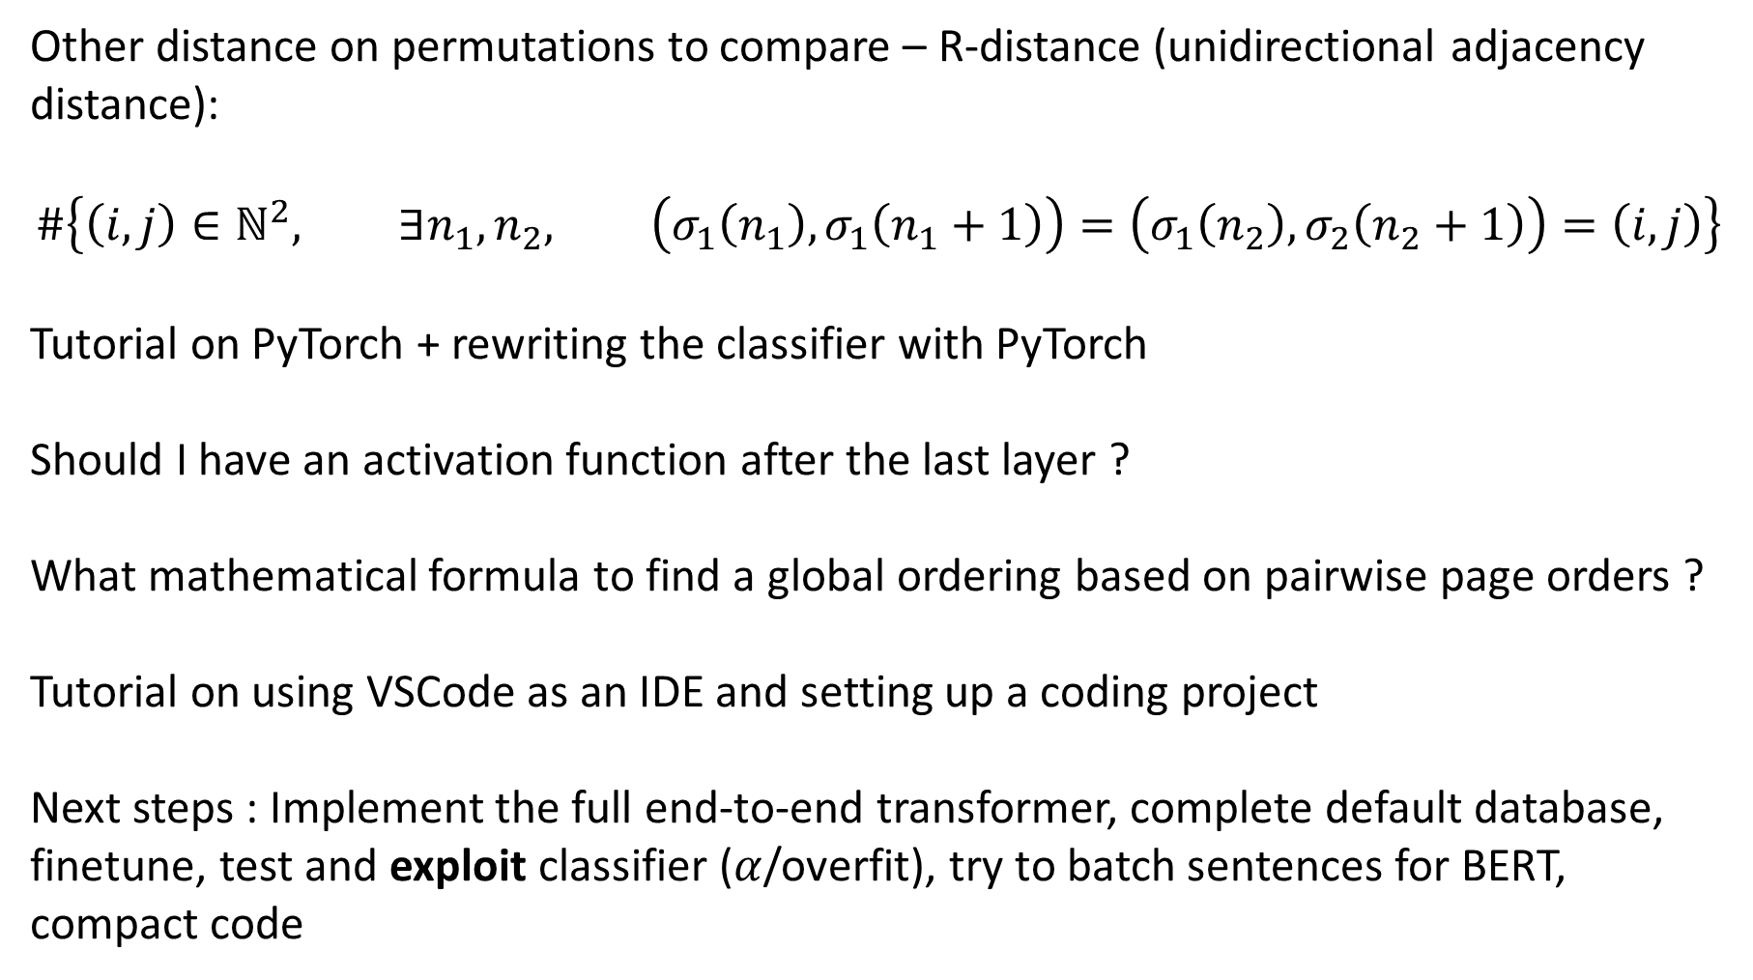
Other distance on permutations to compare – R-distance (unidirectional adjacency distance):
$$\#\left\{\left(i,j\right)∈ℕ^{2}, ∃n_{1},n_{2}, \left(σ_{1}\left(n_{1}\right),σ_{1}\left(n_{1}+1\right)\right)=\left(σ_{1}\left(n_{2}\right),σ_{2}\left(n_{2}+1\right)\right)=\left(i,j\right)\right\}$$
Tutorial on PyTorch + rewriting the classifier with PyTorch
Should I have an activation function after the last layer ?
What mathematical formula to find a global ordering based on pairwise page orders ?
Tutorial on using VSCode as an IDE and setting up a coding project
Next steps : Implement the full end-to-end transformer, complete default database, finetune, test and exploit classifier ($α$/overfit), try to batch sentences for BERT, compact code

Slide 6
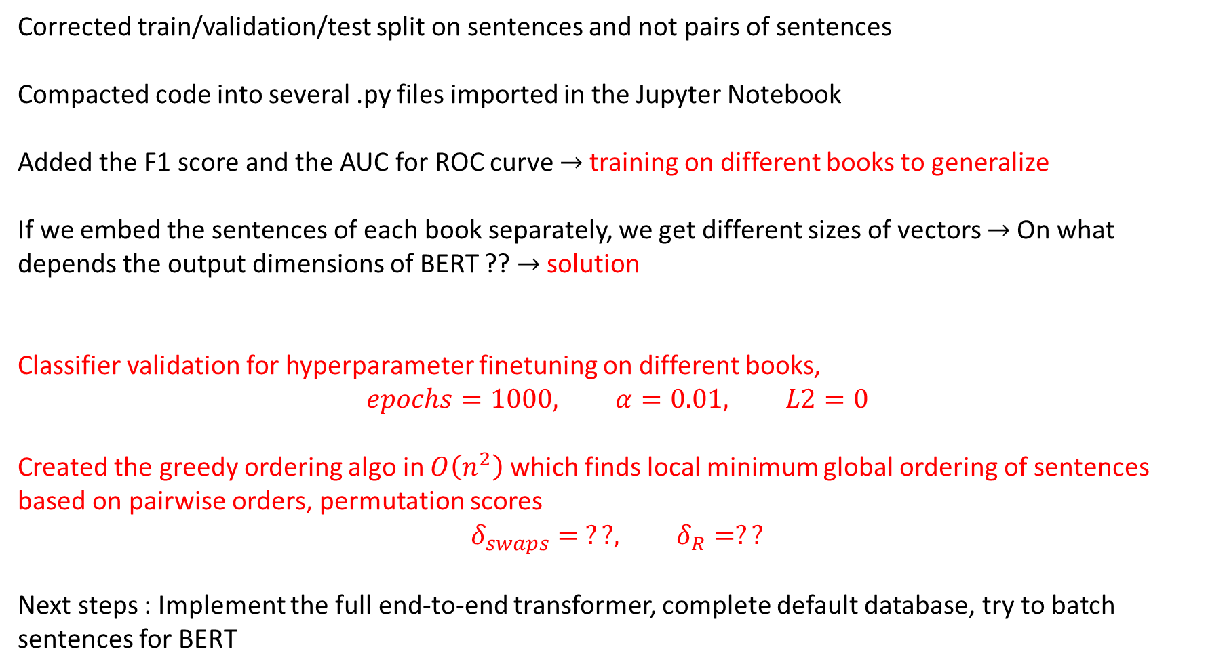
Corrected train/validation/test split on sentences and not pairs of sentences
Compacted code into several .py files imported in the Jupyter Notebook
Added the F1 score and the AUC for ROC curve $→$training on different books to generalize
If we embed the sentences of each book separately, we get different sizes of vectors $→$ On what depends the output dimensions of BERT ?? $→$ solution
Classifier validation for hyperparameter finetuning on different books,
$$epochs=1000, α=0.01, L2=0$$
Created the greedy ordering algo in $O\left(n^{2}\right)$ which finds local minimum global ordering of sentences based on pairwise orders, permutation scores
$$δ_{swaps}= ??, δ_{R}=??$$
Next steps : Implement the full end-to-end transformer, complete default database, try to batch sentences for BERT

Slide 7
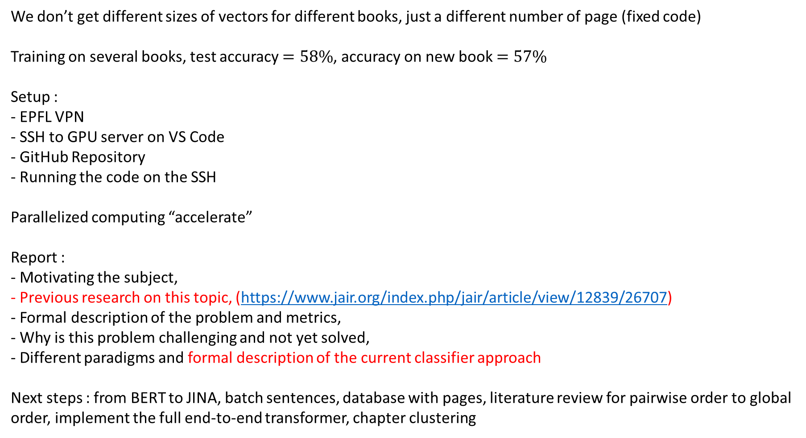
We don’t get different sizes of vectors for different books, just a different number of page (fixed code)
Training on several books, test accuracy $=58\%$, accuracy on new book $=57\%$
Setup :
- EPFL VPN
- SSH to GPU server on VS Code
- GitHub Repository
- Running the code on the SSH
Parallelized computing “accelerate”
Report :
- Motivating the subject,
- Previous research on this topic, (https://www.jair.org/index.php/jair/article/view/12839/26707)
- Formal description of the problem and metrics,
- Why is this problem challenging and not yet solved,
- Different paradigms and formal description of the current classifier approach
Next steps : from BERT to JINA, batch sentences, database with pages, literature review for pairwise order to global order, implement the full end-to-end transformer, chapter clustering

Slide 8
Literature survey on set-to-sequence problems in ML (40 pages) :
https://www.jair.org/index.php/jair/article/view/12839/26707
Design a solution using a permutation invariant input :
Report:
- formal description of the current classifier approach
- summary of the points related to set-to-sequence in the survey
- description of the transformer approach
- description of the permutation invariant approach
Next steps : from BERT to JINA, batch sentences, database with pages, implement the full end-to-end transformer, implement permutation invariant method, chapter clustering, maybe intent detection (COPA)

Slide 9
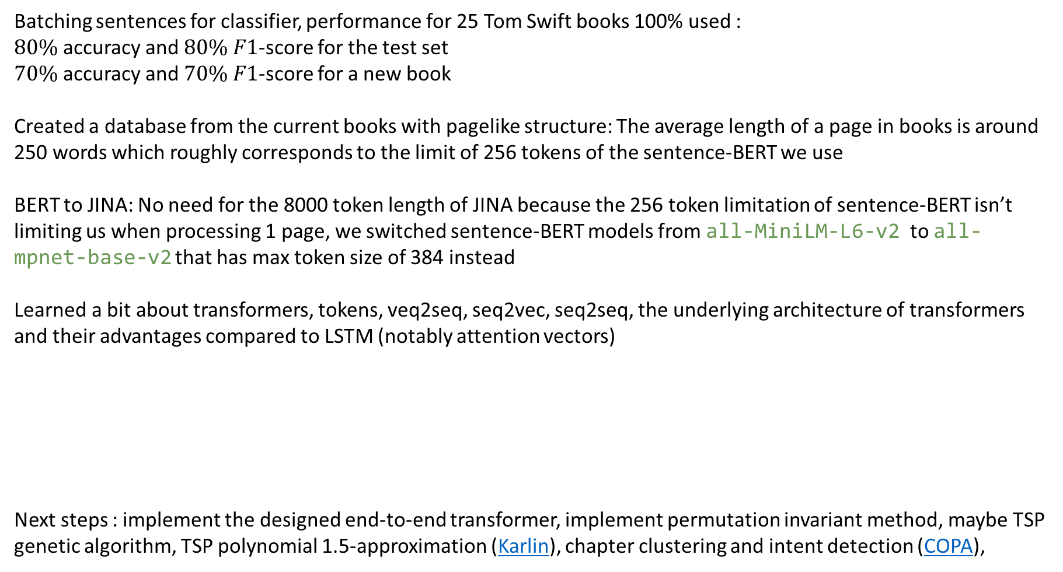
Batching sentences for classifier, performance for 25 Tom Swift books 100% used :
$80\%$ accuracy and $80\%$ $F1$-score for the test set
$70\%$ accuracy and $70\%$ $F1$-score for a new book
Created a database from the current books with pagelike structure: The average length of a page in books is around 250 words which roughly corresponds to the limit of 256 tokens of the sentence-BERT we use
BERT to JINA: No need for the 8000 token length of JINA because the 256 token limitation of sentence-BERT isn’t limiting us when processing 1 page, we switched sentence-BERT models from all-MiniLM-L6-v2 to all-mpnet-base-v2 that has max token size of 384 instead
Learned a bit about transformers, tokens, veq2seq, seq2vec, seq2seq, the underlying architecture of transformers and their advantages compared to LSTM (notably attention vectors)
Next steps : implement the designed end-to-end transformer, implement permutation invariant method, maybe TSP genetic algorithm, TSP polynomial 1.5-approximation (Karlin), chapter clustering and intent detection (COPA),

Slide 10
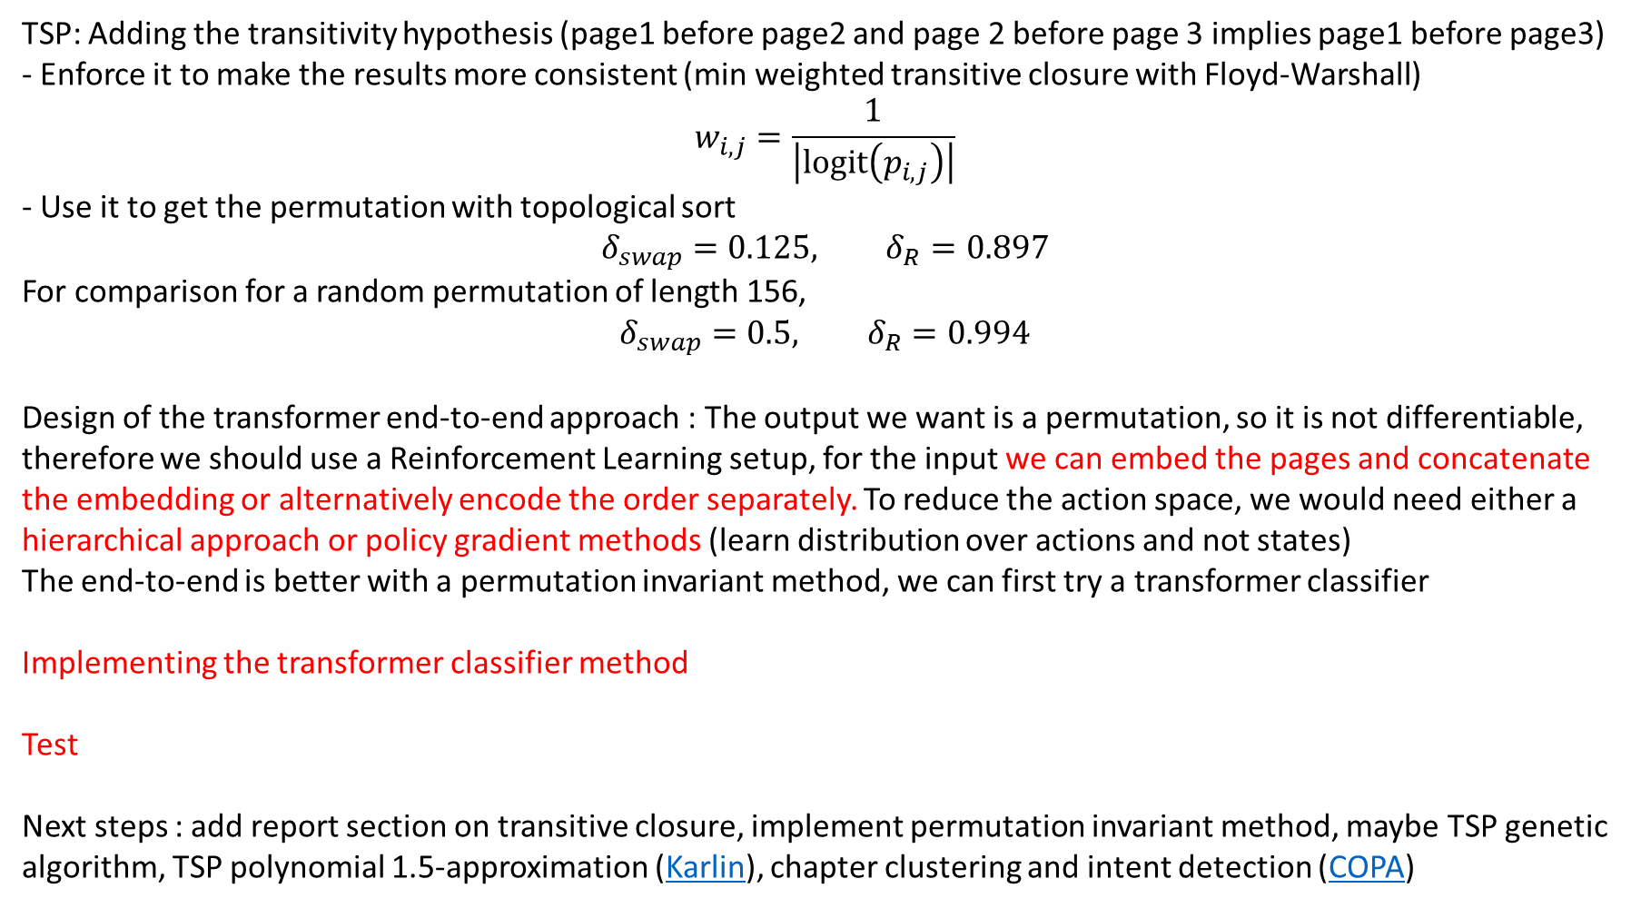
TSP: Adding the transitivity hypothesis (page1 before page2 and page 2 before page 3 implies page1 before page3)
- Enforce it to make the results more consistent (min weighted transitive closure with Floyd-Warshall)
$$w_{i,j}=\frac{1}{\left|logit\left(p_{i,j}\right)\right|}$$
- Use it to get the permutation with topological sort
$$δ_{swap}=0.125, δ_{R}=0.897$$
For comparison for a random permutation of length 156,
$$δ_{swap}=0.5, δ_{R}=0.994$$
Design of the transformer end-to-end approach : The output we want is a permutation, so it is not differentiable, therefore we should use a Reinforcement Learning setup, for the input we can embed the pages and concatenate the embedding or alternatively encode the order separately. To reduce the action space, we would need either a hierarchical approach or policy gradient methods (learn distribution over actions and not states)
The end-to-end is better with a permutation invariant method, we can first try a transformer classifier
Implementing the transformer classifier method
Test
Next steps : add report section on transitive closure, implement permutation invariant method, maybe TSP genetic algorithm, TSP polynomial 1.5-approximation (Karlin), chapter clustering and intent detection (COPA)

Slide 11
Finished implementing the permutation invariant method
Next steps : improve permutation invariant method, maybe TSP genetic algorithm, TSP polynomial 1.5-approximation (Karlin), chapter clustering and intent detection (COPA)

